Slide 1
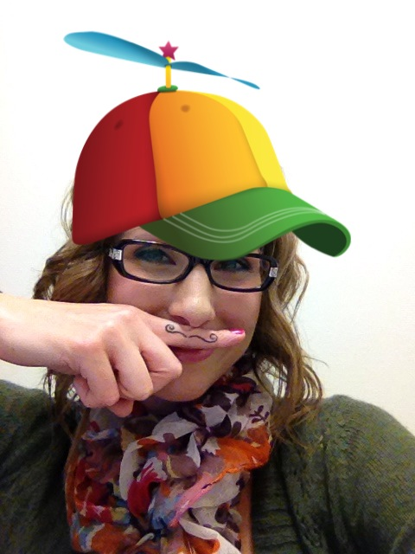

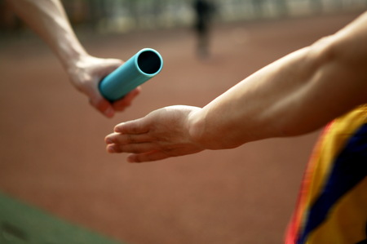
Preventing Burnout
Financial disclosure:
Nothing to disclose
Lynn Lawrence, MSOL, CPOT, ABOC, COA, OSC

Slide 2
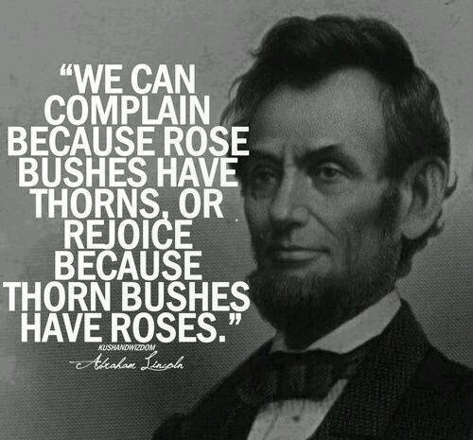

Slide 3
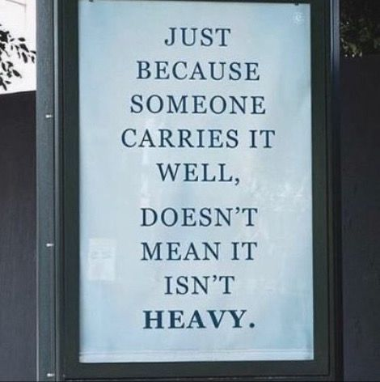
Overview
Defining Burnout
The Importance of Identifying Burnout
Signs of Burnout
Factors Contributing To Burnout
Helpful Hints in Combating Burnout

Slide 4
Stress Across
How stressed are U.S. workers right now? According to LinkedIn’s latest Workforce Confidence Index, stress levels correlate closely with where you work. Stress is highest in the arts industry, where 84% reported work-related stress.
Other industries that largely rely on in-person contact — including healthcare (75%), education (73%) and recreation (73%) — also show high stress.
(1) What's your stress level? Each industry, from arts to tech, has its own profile | LinkedIn

Slide 5
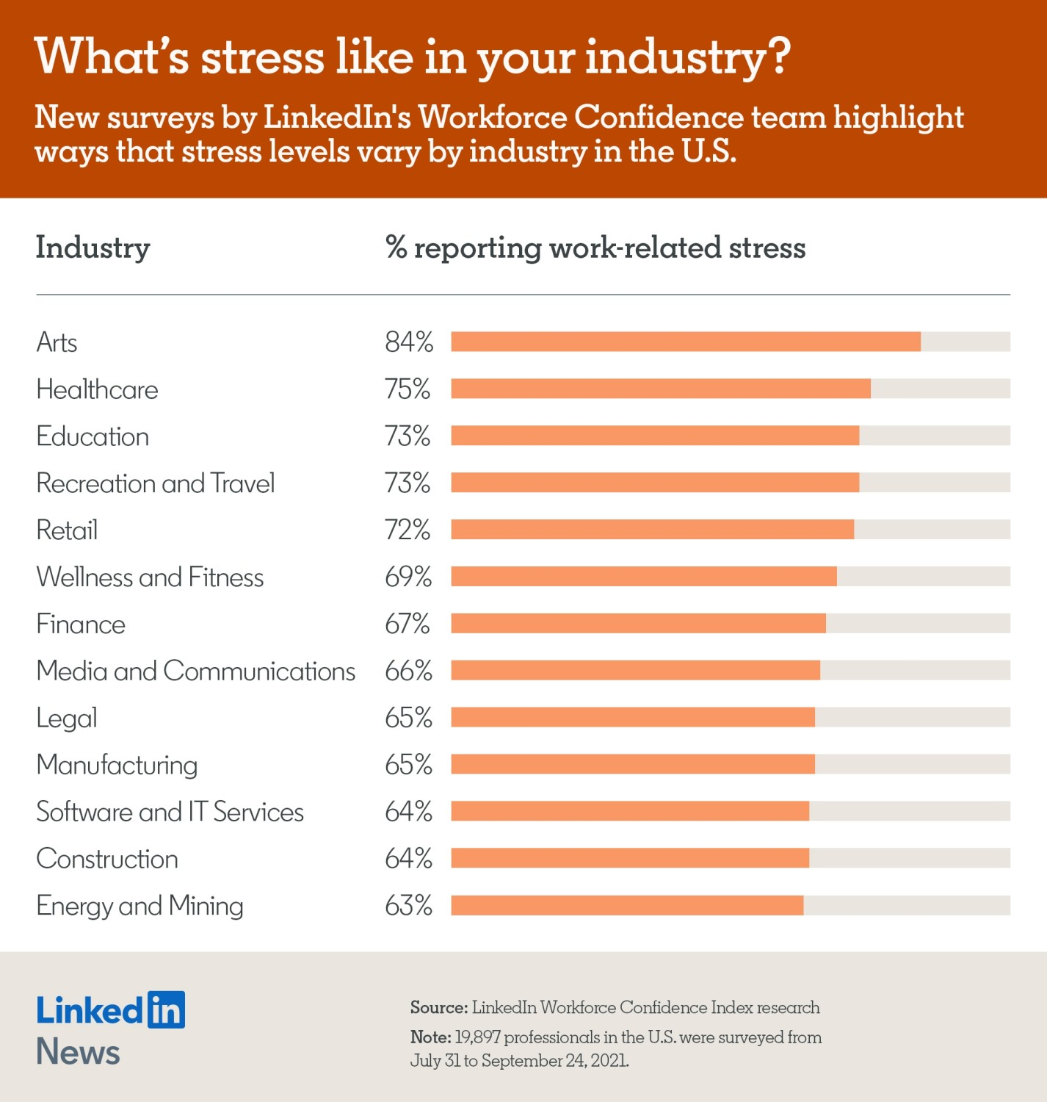

Slide 6
Article by Michael Sopher
The study defines burnout as experiencing a loss of enthusiasm for work, feelings of cynicism, and a low sense of personal accomplishment. The burnout rates are highest among critical care and emergency department physicians (53 and 52 percent, respectively), but even specialties such as ophthalmology and pediatrics ranked above 40 percent. Women reported higher burnout rates than men (51 and 43 percent, respectively).
https://www.linkedin.com/pulse/doctor-burnout-how-spot-fix-michael-sopher?trk=eml-b2_content_ecosystem_digest-network_publishes-239-null&midToken=AQEOCEYh-iM9rg&fromEmail=fromEmail&ut=2TDlAjI-ZTeCU1

Slide 7
Cont…
It’s important to realize that burnout is not just a problem for individual overworked doctors – burnout has serious, farther-reaching effects. These doctors (and other health care workers who are burned out) are at higher risk for substance abuse and suicide, more likely to make errors and questionable ethical choices, and may lose their sense of empathy for others, according to this post on The New York Times’ Well blog. They are also more likely to leave medicine

Slide 8
Top 3 Reasons for BO
The top three causes of doctor burnout reported in the MedScape study were:
Too many bureaucratic tasks
Spending too many hours at work
Income not high enough

Slide 9
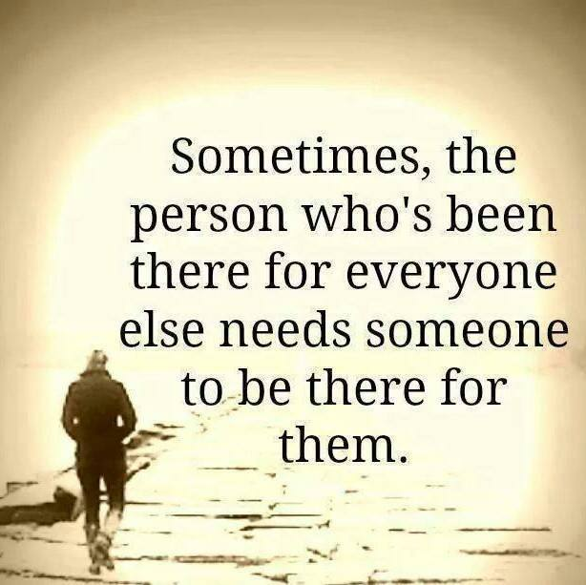

Slide 10
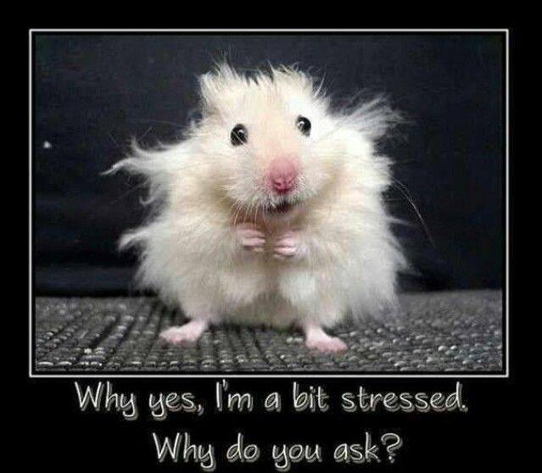

Slide 11
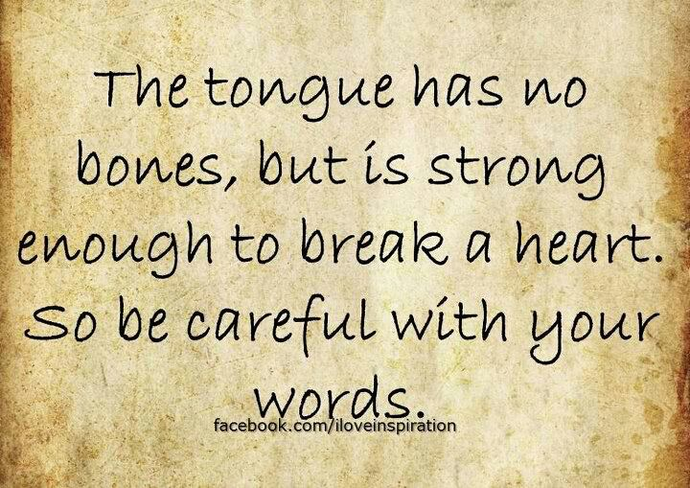

Slide 12
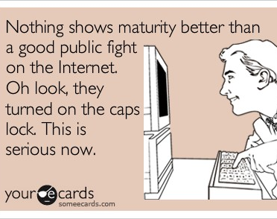
Two Types of People Get Burned out
Those that care
Those that used to care

Slide 13
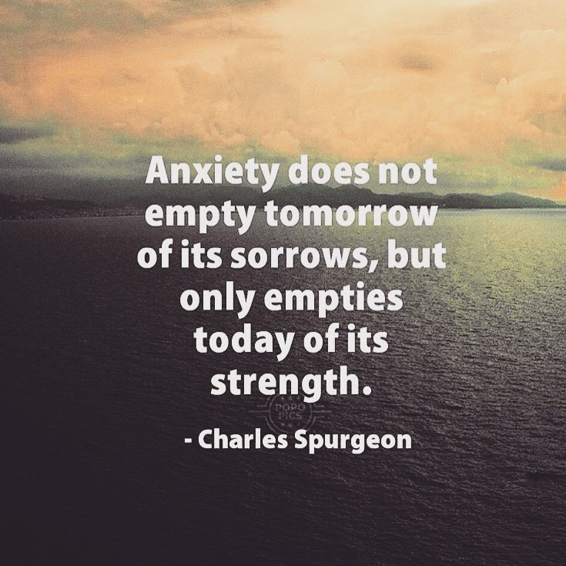

Slide 14
#1 Reason For Sickness
Did you know that the number-one reason for sickness and disease in America today is stress? That the number-one reason for prescribed medications is anxiety? That stress and anxiety lead to more doctor's office visits than anything else? Stress is literally killing us.
Jimmy Evans

Slide 15
Anxiety
Fear is a negative emotion caused by a real or perceived threat to our well-being. Anxiety is unease and nervousness about an event, person, or problem we can't control. Worry is to dwell mentally on difficulty or trouble with chronic concern.

Slide 16
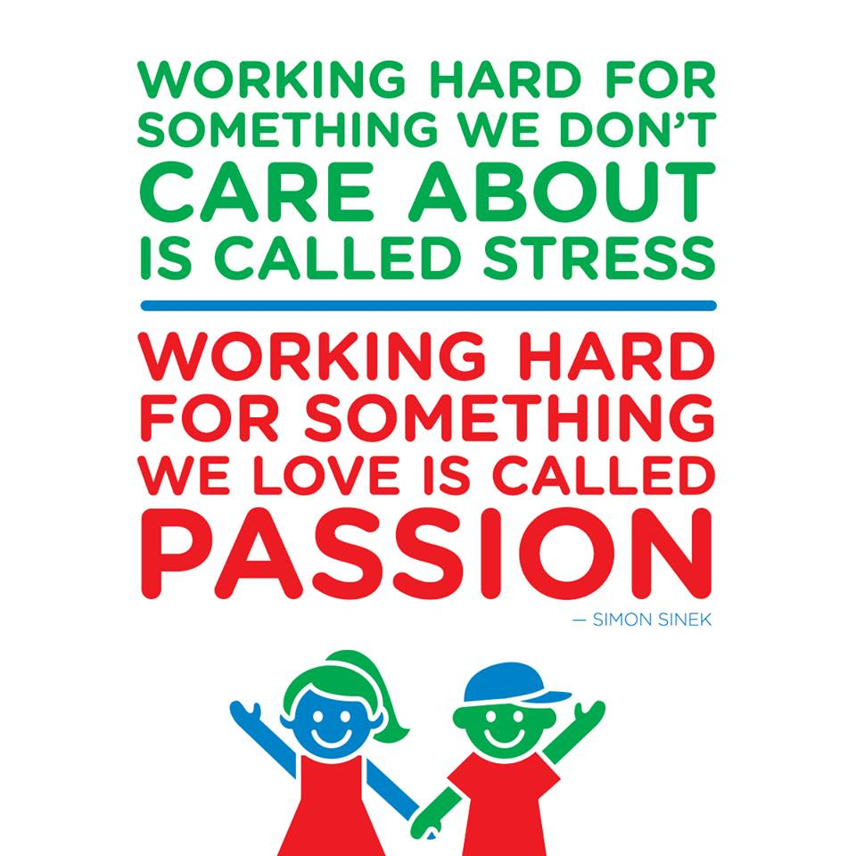
Worry or Fear
Worry can turn into anxiety. Anxiety can turn into fear. They're all the same emotion, just at different levels. But in Scripture, we're commanded not to fear, not to be anxious, and not to worry.

Slide 17
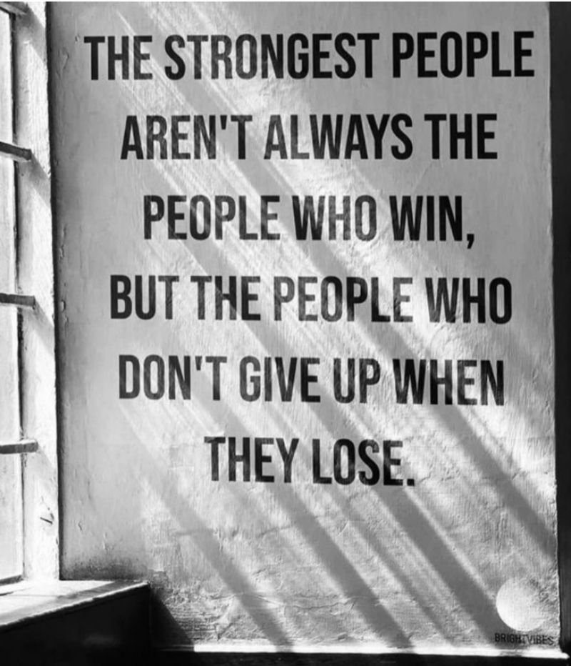
Failure
It takes two things to fail:
Loss of desire
Loss of hope

Slide 18
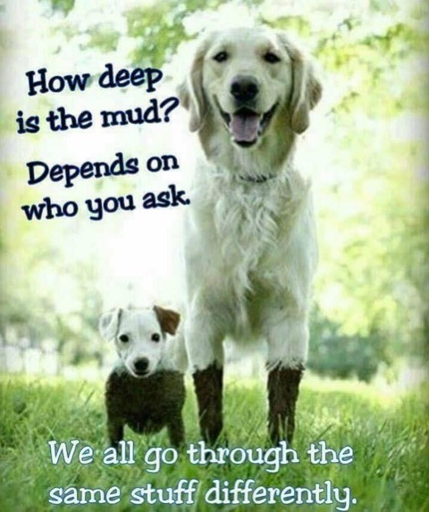

Slide 19
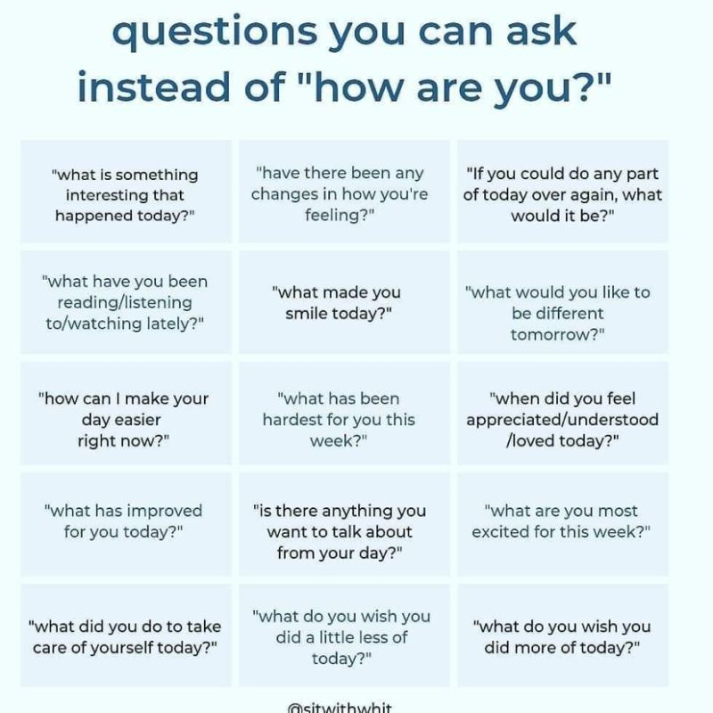
Defining Burnout
Burnout results when individuals experience increasing amounts of negative stress, emotional exhaustion and depersonalization….
Job Stress, a state of fatigue…

Slide 20

Another Definition
Burnout is a state of emotional, mental, and physical exhaustion caused by excessive and prolonged stress. It occurs when you feel overwhelmed and unable to meet constant demands. As the stress continues, you begin to lose the interest or motivation that led you to take on a certain role in the first place.

Slide 21
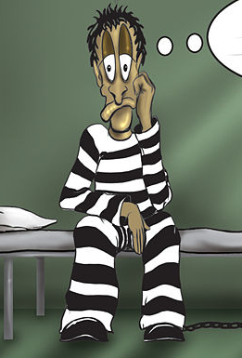
Stress Will Imprison You
Makes you think negative thoughts
Occupies the majority of your time
Prevents you from loving your love ones
Makes you physically ill
Can kill you

Slide 22
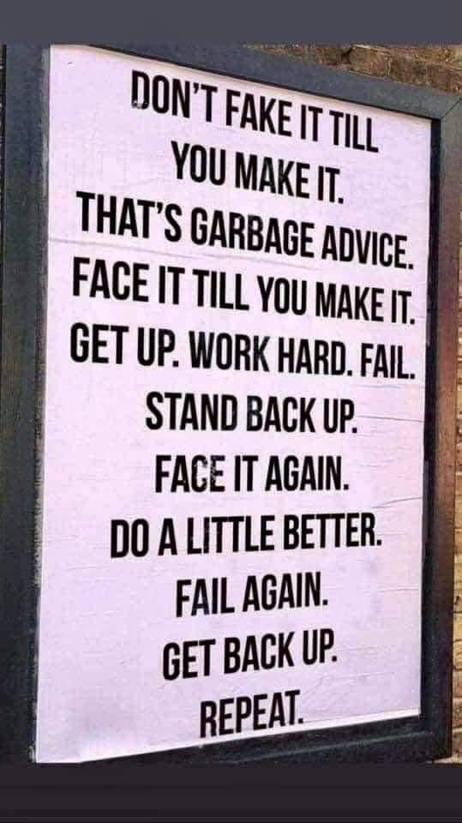
Importance of Identifying Burnout
Burnt out employees are employees that care about what they are doing
Only caring employees will experience burnout
Superstar employees are the last to see burnout in themselves

Slide 23
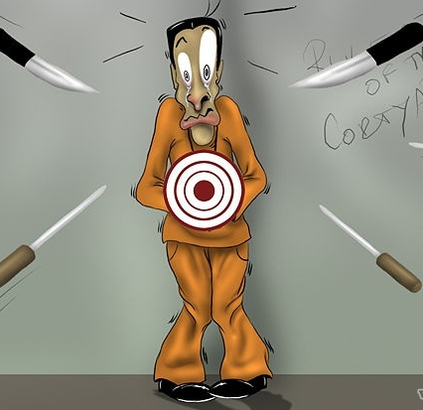
Identifying Burnout
Burnout causes you to disengage or shutdown
What does it look like?
- people relating to each other poorly
- excessive use of power and controls when dealing with staff or patients

Slide 24
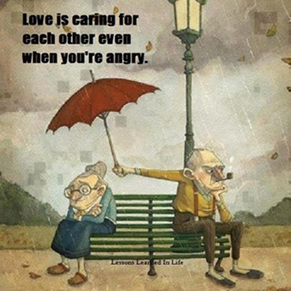
Identifying Burn Out Cont…
Burnout reduces your productivity and saps your energy, leaving you feeling increasingly helpless, hopeless, cynical, and resentful. Eventually, you may feel like you have nothing more to give

Slide 25
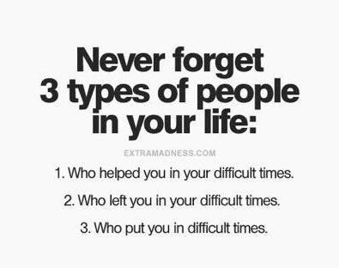
Signs of Burnout
Withdrawn
No energy
No desire
Perception of dread
Having to medicate or use artificial stimulus
Isolation
Lack of focus
Increase sensitivity
No sense of belonging
Fear of conflict

Slide 26
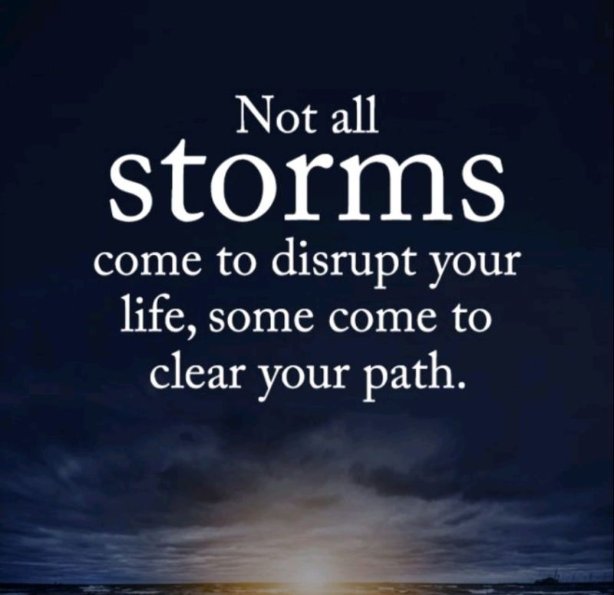
Things might look bad in the moment, but you have been through too much to quit now
What path did you need cleared?

Slide 27
Questions
Will my bottled up feelings of frustration and anger lead to "stress-related illness"?
Is it wrong for me to feel angry
Should friends and neighbors be told
How can I get over my feelings of guilt for wishing I didn't have this big responsibility?
I sometimes feel sad and discouraged and even begin to cry. What can I do?
I feel like I'm facing this all alone. Where can I find support?

Slide 28
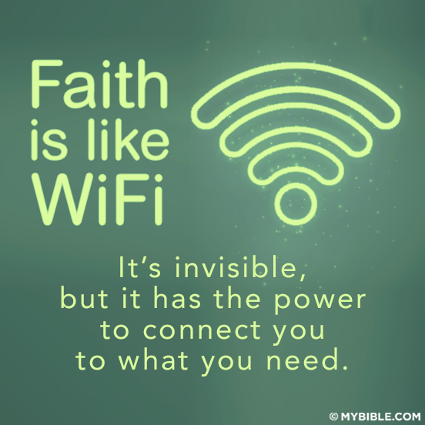

Slide 29
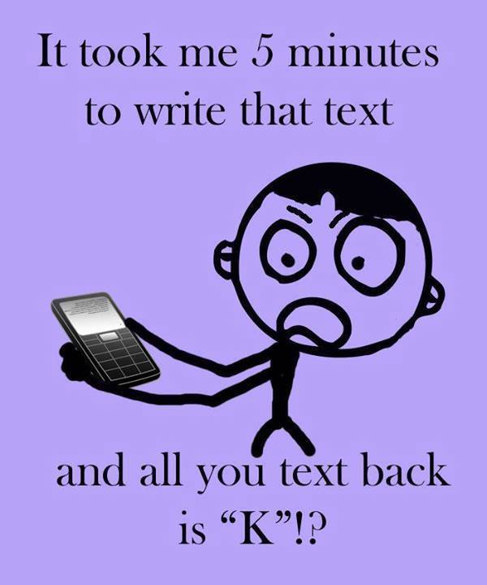

Slide 30
Conflict Occurs
“Conflict is inevitable in organizations. It is a natural outcome of human interaction that begins when two or more employees come in contact with one another in attaining their objectives. Relationships among such entities may become incompatible or inconsistent when two or more of them desire a similar resource that is in short supply; when they have partially exclusive behavioral preferences regarding their joint action; or when they have different attitudes, values, beliefs, and skills” (Rahim, 2011).

Slide 31
1926 Mary P. Follett
The styles of handling interpersonal conflict in organizations were first conceptualized in 1926 by Mary P. Follett (1940). She discussed three main ways of handling organizational conflict: domination, compromise, and integration—as well as other, secondary ways of handling conflict, such as avoidance and suppression.

Slide 32
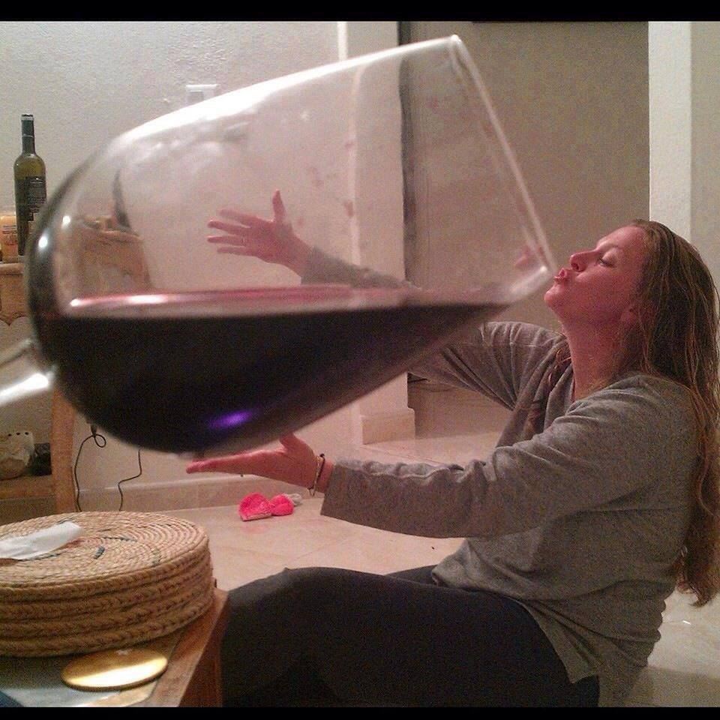

Slide 33
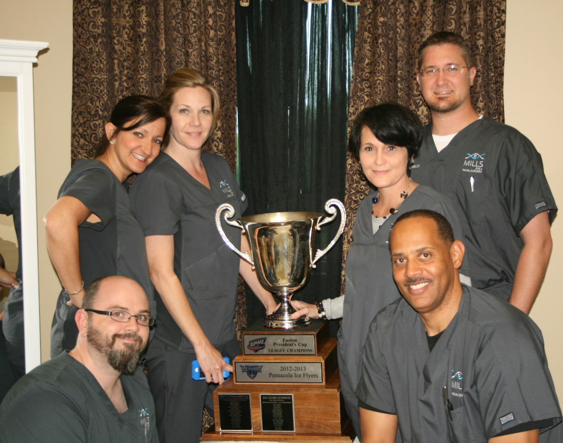
Who Gets Burned Out?
Who gets burnout
  Doctors
  Para’s
  Patients
  Receptionist
  Entire Staff

Slide 34
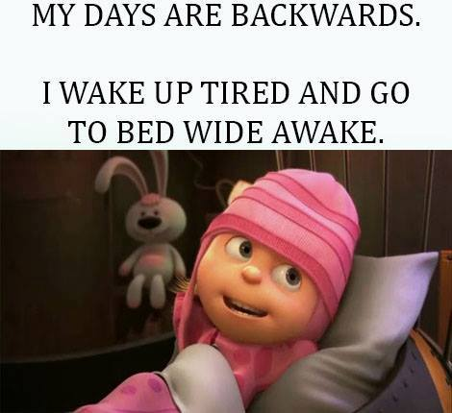

Slide 35
Employee Burnout Signs
3 times more likely to be ill
No longer laugh of have fun
Who are unusually irritable towards customers and co-workers
Those who see work as a chore
Those who overly worry about everything
Those who’s inability to be effective no matter the effort
Isolation, not wanting to be a part of the team

Slide 36
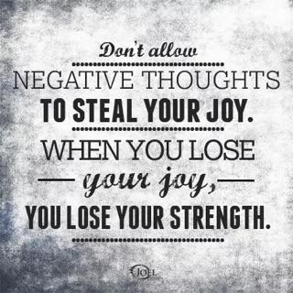
Contributing Factors
Excessive workloads .... paraoptometrics do it all!
Inadequate training and job preparation
Lack of resources
Excessive negative criticism, lack of positive feedback
Lack of role clarity
No professional support
Communication
A stressful home life or relationship
Health (including a lack of sleep)

Slide 37
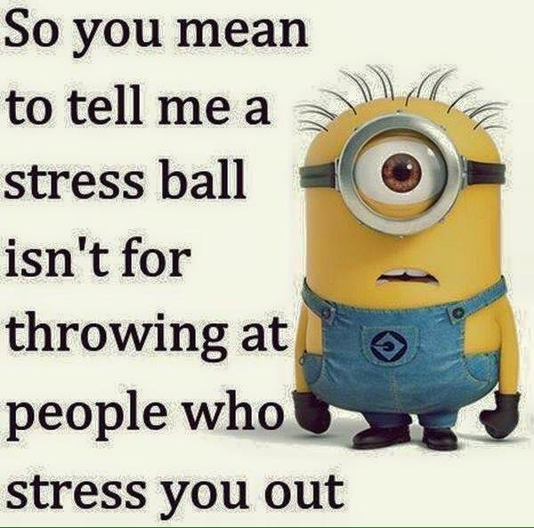
Cont…
Burnout may also be caused by staying too many years in one position or with one company. And, even working amidst the atmosphere of the most vibrant company, an individual with too many commitments, not enough recreational time, and no effective stress reduction skills will be much more prone to burnout

Slide 38
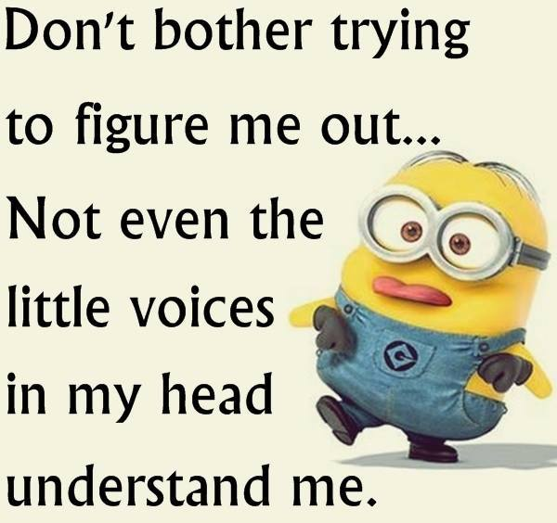
Cont…
Lack of praise and direction from supervision will certainly contribute to employee burnout. On a deeper level, if a person is feeling anxiety, anger, and/or fear, on an ongoing basis, in relation to his coworkers, the population he serves in his role, or the practices of his company, this can be a fast-track to burnout."

Slide 39
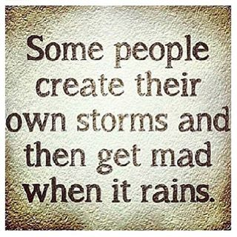
What are Workplace Stressors
Chaos
Lack of standards
Absent or mis-guided leadership
Poor training
Lack of resources
Poor communication amongst the staff
Lack of consistency
Lack of accountability top down
Lack of recognition
Not being challenged

Slide 40
Impact of Burnout
What type of impact can work burnout have on someone's overall life? "The effects of burnout at the workplace are increased absenteeism and decreased creativity, productivity, and overall quality of work. Someone who's burned-out is more likely to experience fatigue, irritability, and feelings of depression or anxiety.

Slide 41
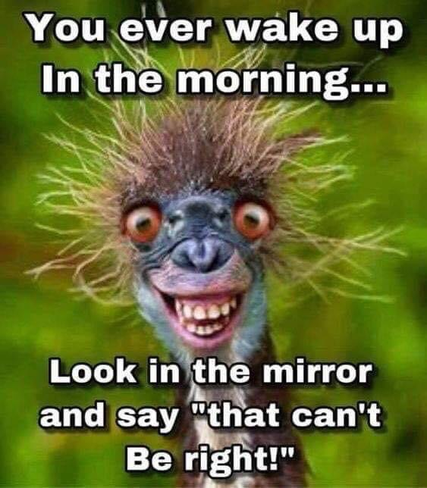

Slide 42
Cont…
Sense of failure, lack of motivation, no appetite
Individuals experiencing burnout may also find themselves seeking excitement or attempting to counter-balance through quick-fix stimuli like drugs or alcohol that have potentially negative consequences when used in the long-term as a band-aid for burnout."

Slide 43
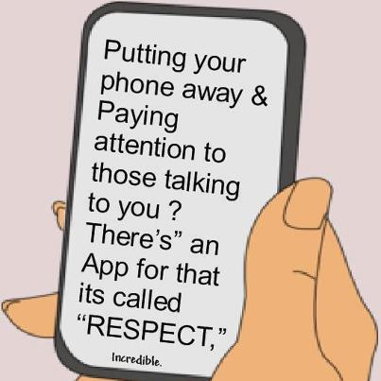
Management Helpful Hints
Establish Clear Goals and Visions
Establish clear guidelines: Job Descriptions, Goals, Visions, Chain of Command…etc
Accountability for the top down
Address burnout signs immediately

Slide 44
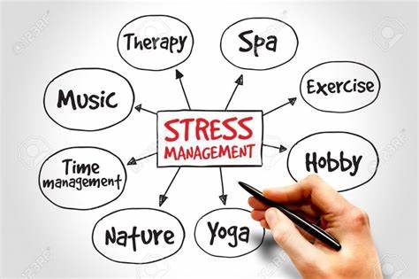

Slide 45
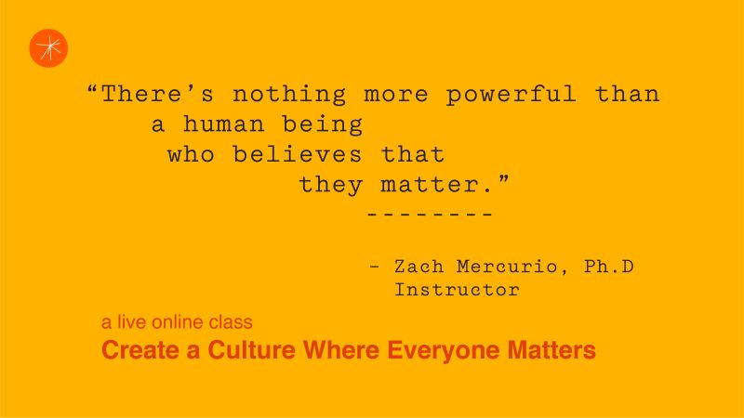
Leadership
Must be visible
Must be available
Must act when necessary
Must be unified
Must save employees

Slide 46
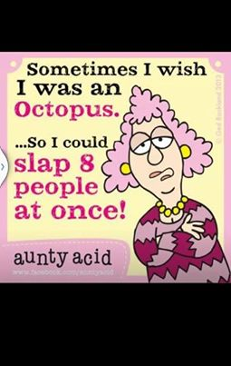
Preventing Burn Out
You must first recognize burnout
You must address burn out (supervisor, spouse, friend, someone who will tell you the truth)
You must be willing to get help
You must set boundaries and monitor your progress
Be health conscientious

Slide 47
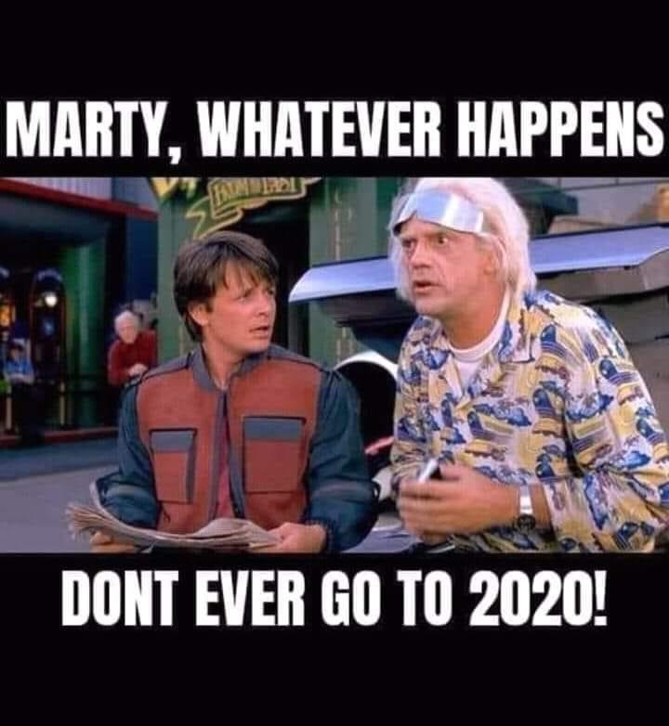

Slide 48
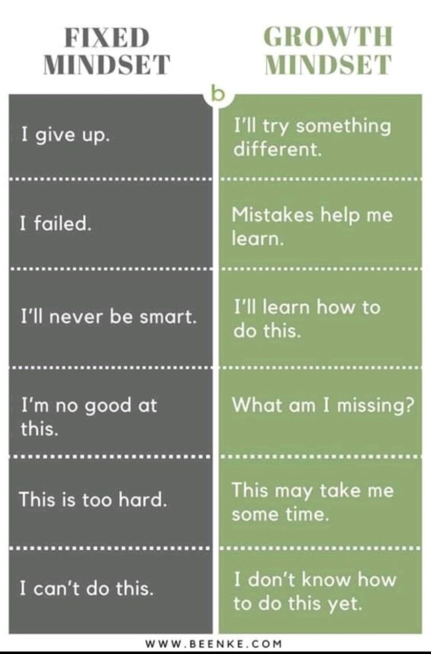
Employee Helpful Hints
Seek helpful supervision
Validate expectations
Practice good/effective communications
Build a support system, not a clique
Look for solutions to problems, not problems
Log your successes and failures…learn from them
Take personal responsibility for your attitude
Admit burnout is a problem for you
Notes:
Ask someone you trust for help
Know what is expected
Effective communications is a must…how many of you are married? Do you know that 65% of those marrying today are divorcing? Is it because they don’t love each other any more? I don’t think so, I believe it is because people no longer effectively communicate…
Test: Everyone please stand….if you feel you are an effective communicator, please remain standing…. Now, if your significant other would say your are an effective communicator please stay standing… Listening is our most neglected communicating skill.
Young folks…
Not all problems have an easy answer…don’t complain unless you have a recommendation for a solution….

Slide 49
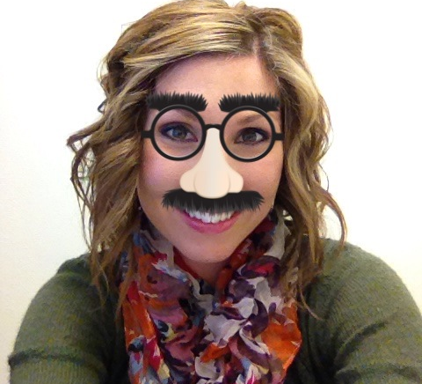
Have Fun

Slide 50
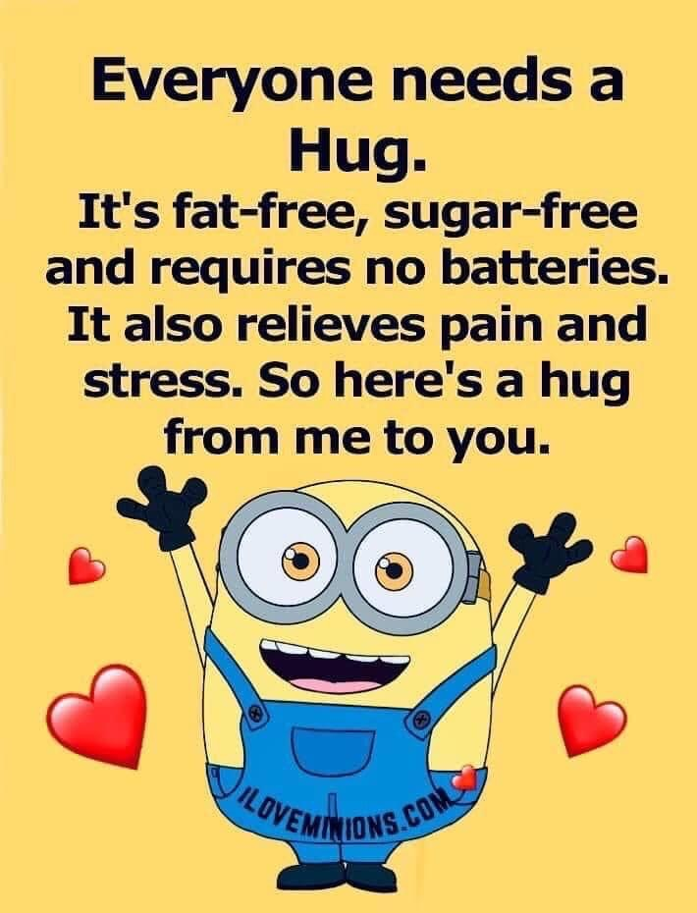

Slide 51
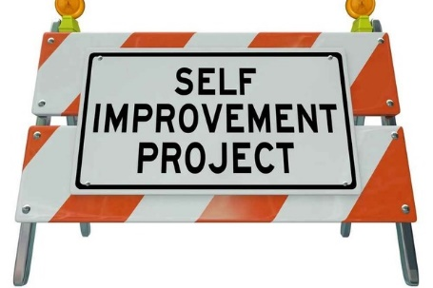
What is your plan to get better?

Slide 52

Faith In God
If you have faith in God, make Him a priority at the start of the day, don’t just use Him to save you, allow Him to be your Shepherd
Faith in God will give you hope for the entire day, and you will have something left at the end of the day

Slide 53


Slide 54
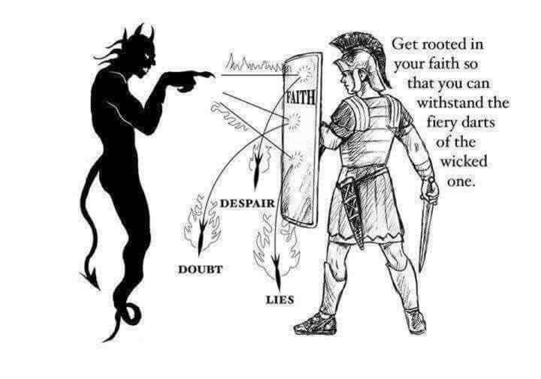

Slide 55


Today’s Cultural Pressure

Slide 56
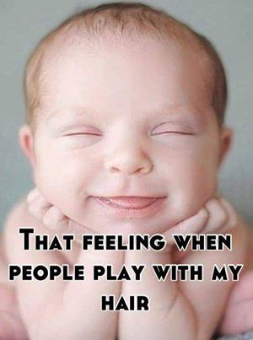
Employee Helpful Hints Cont…
Come to work with a purpose…learn something new daily, create some job diversity
Make sure you are not trying to do too much
Ask for help when you need it
Reward yourself for your personal successes
Take adequate breaks from work…lunch, vacations etc.
Find a proper balance between work and home life
Have a personal development plan
Notes:
You won’t repair something you don’t think is broke

Slide 57
Cont…
What are some tips for preventing burnout in the workplace? "Thankfully, there are many approaches for preventing burnout in the workplace. We must be sure to take time to and refresh by doing soothing activities: deep breathing, relaxation exercises, meditation, yoga, and/or daily exercise. If you are a person of faith, ask you spiritual leader for help… prayer works!

Slide 58
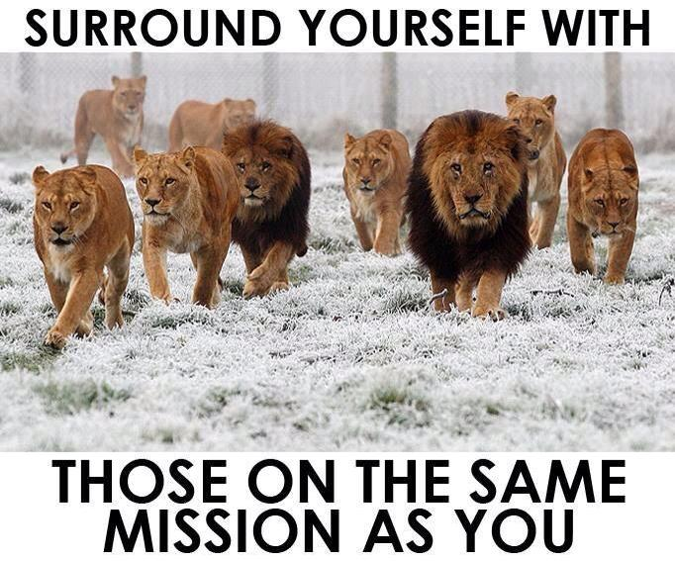

Slide 59
Quote from Charlie Orth on LinkedIn
“Something I’ve come to be really passionate about as a manager is how you should treat your people. I’ve found myself slowly starting to realize how easy it is for leaders and managers to become what I’d like to call “people blind”.
You begin to start treating your staff as just workers, shift covers, bodies in places or simply just someone who’s only responsibility is to do their job. Managers fail to see that they are more than that but actual people who will make mistakes, will not always perform at the top tier, will have good days and bad days. I’ve come to realize that one of the things I am passionate about is coaching people on how to do better instead of tossing them aside once they mess up. I believe that this is how you form a great team! Will people mess up? Yes. Will people sometimes choose to not get better or improve? Of course! But that doesn’t mean you don’t give them a shot first. If they fall, help them get back up. See the potential in someone before giving up on them.”

Slide 60
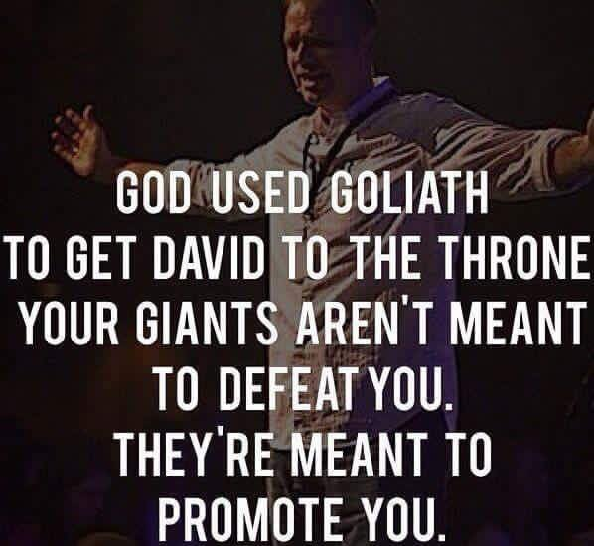

Slide 61
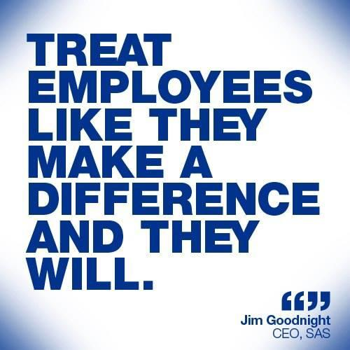
You Need To Care About You
Even if you feel no one else cares about you, you need to care about you
Get involved in something that builds you up on the inside
Go for as walk and sing your favorite, don’t replay the awful event

Slide 62


Slide 63
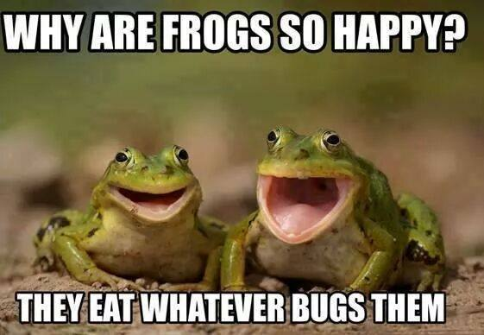

Slide 64

Plant a New You Daily
We must fertilize the garden of our work via continuing education and the setting of new goals in our lives (even if some of those goals aren't specifically work-related). If you plant the same type of seeds year after year, you won't get much variety in your garden. Therefore, be sure to expand your professional network, even if it's reaching out randomly and meeting one new person in your field every few months over coffee

Slide 65

Employer Helpful Hints
Create an atmosphere that promotes less stress
Create job diversity for employees
Group and personal recognition
Be attuned/implement strategies to prevent stress
Recognized accomplishments, set positive direction
Educate, teach, encourage new task gradually
Give your staff opportunities to speak about issues
Encourage collaboration and teamwork

Slide 66
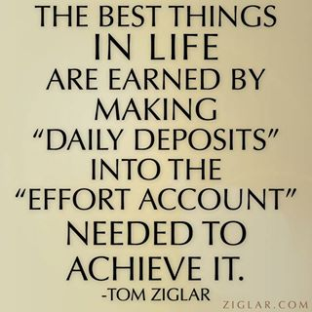
Employer and Employee
This happened over a long period of time, it may take a while to recover
Cutting back on hours may help
Check and recheck
Make adjustments where necessary
Ask for help if what you are doing is not working

Slide 67
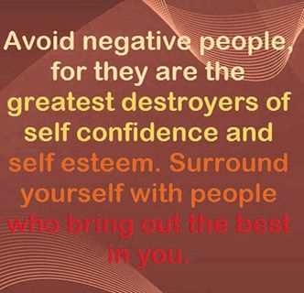
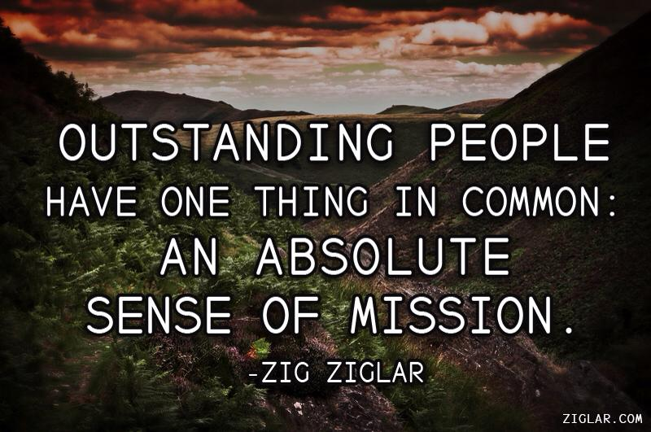
A Contrast

Slide 68
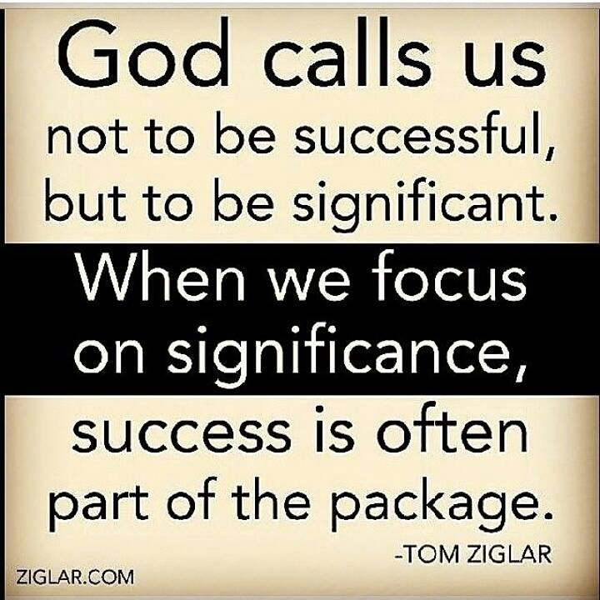
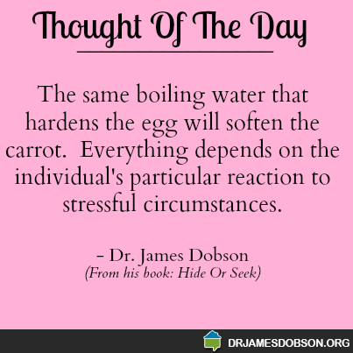
Purpose

Slide 69

Set Goals For Yourself
SMART:
Simple
Measurable
Attainable
Realistic
Timed

Slide 70


Slide 71

Truth
We can learn the things we like a lot faster than we learn the things we don’t like, however they both need to be accomplished

Slide 72


Choose To Win

Slide 73


Slide 74


Slide 75


Slide 76


Slide 77


Avoid Fault Finders

Slide 78


Relax

Slide 79


Slide 80


Slide 81

Make A Difference
Never forget that you can make a difference regardless of the situation, regardless of what others thinks, regardless of the obstacles you may face, you can make a difference
Devonte Hart and Officer Bret Barnum Portland. Oregon Nov 2014

Slide 82


Slide 83

Eat Healthy
Nuts--Stress depletes our B vitamins and snacking on nuts helps replenish them. The potassium in nuts is also key. Penn State researchers found that a couple of servings of potassium-packed pistachios a day can lower blood pressure and reduce the strain stress puts on your heart.

Slide 84

Eat Healthy Cont…
Red Peppers--While oranges get all of the vitamin C hype, red peppers have twice as much. In a study in the magazine Pyschopharmacology, people who took high doses of C before engaging in stress-inducing activities had lower blood pressure and recovered faster from the coritsol surge than those who got a placebo.

Slide 85

Eat Healthy Cont…
Salmon--In a study in the magazine Brain, Behavior, and Immunity people who took a daily omega-3 supplement for 12 weeks reduced their anxiety by 20% compared to the placebo group. Shoot for eating at least two servings of salmon a week or take an Omega-3 supplement.

Slide 86

Eat Healthy Cont…
Spinach--This leafy-green veggie is rich in stress-busting magnesium. People with low-magnesium levels (most of us) are more likely to have elevated C-reactive protein levels. Research shows people with high C-reactive protein levels are more stressed and at a greater risk for depression. And since magnesium gets flushed out of the body when you’re stressed, it’s crucial to get enough.

Slide 87
Eat Healthy Cont…
Dark Chocolate--If you crave chocolate when you’re on edge, have some. Research in the Journal of Proteome Research showed people who ate about 1 ounce daily for two weeks had lower cortisol and fight-or-flight hormone levels. To reap the feel-better rewards, choose chocolate that’s at least 70% cocoa. And remember, dark chocolate is a high-calorie food, so mind your portions.

Slide 88

Tea
Tea--A study from University College London discovered that tea drinkers destressed faster and had lower cortisol levels than those who drank a placebo. In the British Isles, they even practice something called “elevenses.” It refers to a cup of tea and light snack that usually is taken at or around 11 a.m.

Slide 89

Exercise
Exercise is a stress reliever and is healthy for your circulation and blood supply…
Failing to plan, is planning to fail
Get more info…

Slide 90

Motivation Continue

Slide 91

Take Care of You
If you know it is going to be a rough day, be prepared
If everyday is a rough day, you a doing something wrong, readjust
Plan ahead

Slide 92


Slide 93


Slide 94


Slide 95


Slide 96

Review
Defining Burnout
The Importance of Identifying Burnout
Signs of Burnout
Factors Contributing To Burnout
Helpful Hints in Combating Burnout

Slide 97

Questions?
Thank You
martralyn@msn.com

